Slide 1
Control Software Summary

Slide 2
Overview
Pilot Interface
Overview
Interface Overview
Primary Flight Display
Hand Controls
Mission Control
Common Operating Picture
System Status
Sensor Control

Slide 3
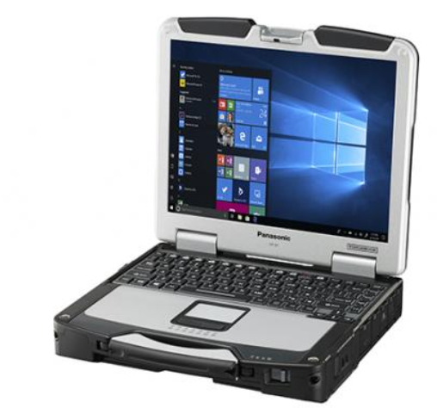
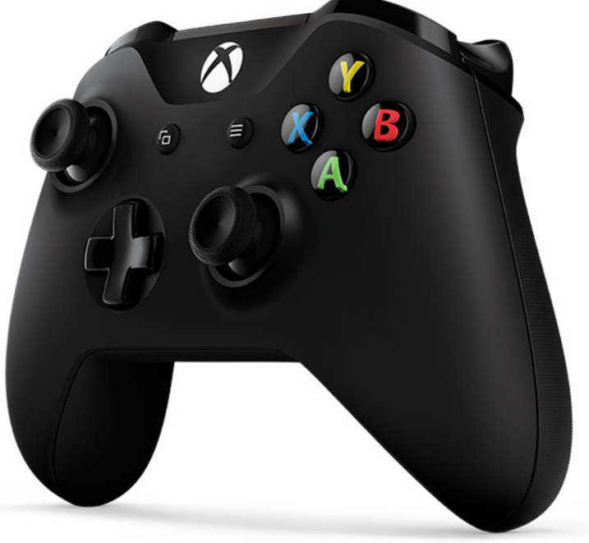
Pilot Interface Overview

Slide 4
Interface Overview
Primary Flight Display
FMV / Imagery Display
Map Display
Message Center
Health Monitor

Slide 5
Primary Flight Display
Roll Angle
Airspeed
Altitude
Lateral Speed
Vertical Speed
Pitch Angle
Yaw Angle
Heading

Slide 6
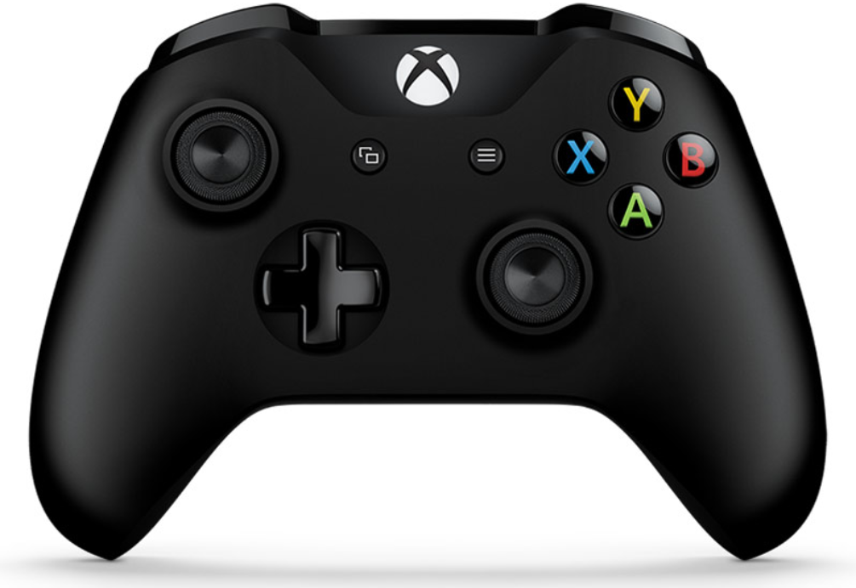
Hand Controls
Shoulder: Decrease Altitude
Trigger: Yaw Left
Select
Shoulder: Increase Altitude
Trigger: Yaw Right or Take Picture
Back
Lateral Velocity Controls
FMV Zoom Out
Open/Close Menu
FMV Zoom In
Menu Control Buttons
Roll / Pitch Angle Control
FMV Pan / Tilt (when FMV control is active)

Slide 7
Common Operating Picture
Popup for route planning
Integrated map display and route planner
Map
Weather data
Threat data
Blue Force data
Available data will depend on external connections or organic sensors
Route Planner enables creation / management of autopilot routes
Can be externally built or locally built
Intuitive interface
Right click to add waypoint on cursor
Select a waypoint to edit

Slide 8
System Status Page
Health status shows the status of all system components
Each component can be turned on or off
Some can be reset or commanded to execute built-in-test
Page can also be used to adjust communications settings
Comms settings

Slide 9
Sensor Controls
FMV
Controlled via primary controller
Simply push in Button 3 to enable control, then right stick pans and tilts camera
Zoom is executed via A and B buttons
The right trigger can be used to take a still image when the FMV control is enabled
Wide Area
Wide Area images are commanded via the menu
Pictures can be taken manually or automatically
Wide area camera menu control

